Slide 1



Sustainability Comms To Engage Consumers
Creating Differentiation & Value
CONFIDENTIAL
March 2023

Slide 2


Who are SKIM?
One of Danone’s (favourite!) strategic partners, consulting and collaborating with Danone S&I, conducting global market research to have parent’s opinions central to business decisions.
We reach parents, patients, HCPs using a range of agile, interactive and intuitive research techniques. We help Danone test innovations, communications, pricing strategies, understand their journeys… fundamentally what decisions do people make regarding your products and why.
David Voxlin Sustainability Director, SKIM

Slide 3

Market & Consumer Context
Notes:
In the middle of the the pandemic

Slide 4
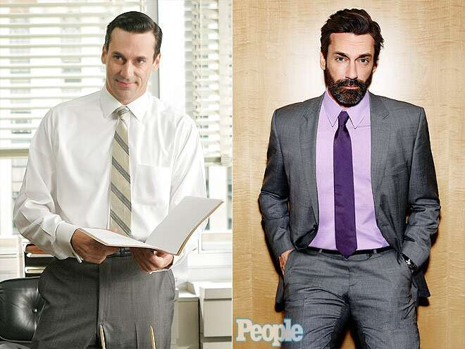

Social change can take time, but key attitudes have changed beyond recognition in less than two generations
1960
2010
2035
Smoking is hot
Structural racism is acceptable
The patriarchy is doing just fine
Environmentalism doesn’t exist
Climate change, what even is that?
Smoking is banned
Black President
Feminism is mainstream
Environmentalism is law
Climate change is the #1 concern worldwide
Single use plastics are outlawed
Climate change is impacting your life
Beef & dairy are taxed like tobacco
New oil is banned
Jon Hamm remains very, very handsome!

Slide 5
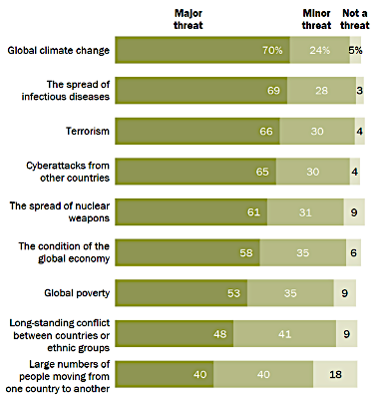
Climate change is now a top concern for citizens of many countries around the world
Source: Pew Research Center (2020)
Notes:
In the middle of the the pandemic

Slide 6
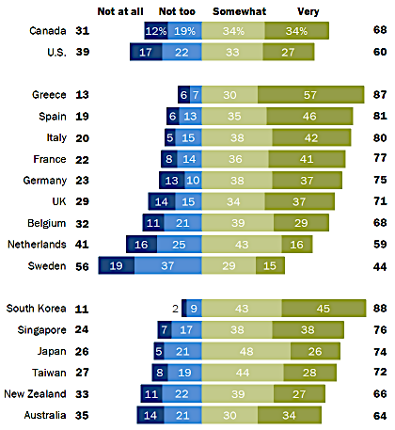
A majority also believe that climate change will have a negative impact on them personally in their life-time
Source: Pew Research Center (2020)
Source: Pew Research Center (2020)

Slide 7
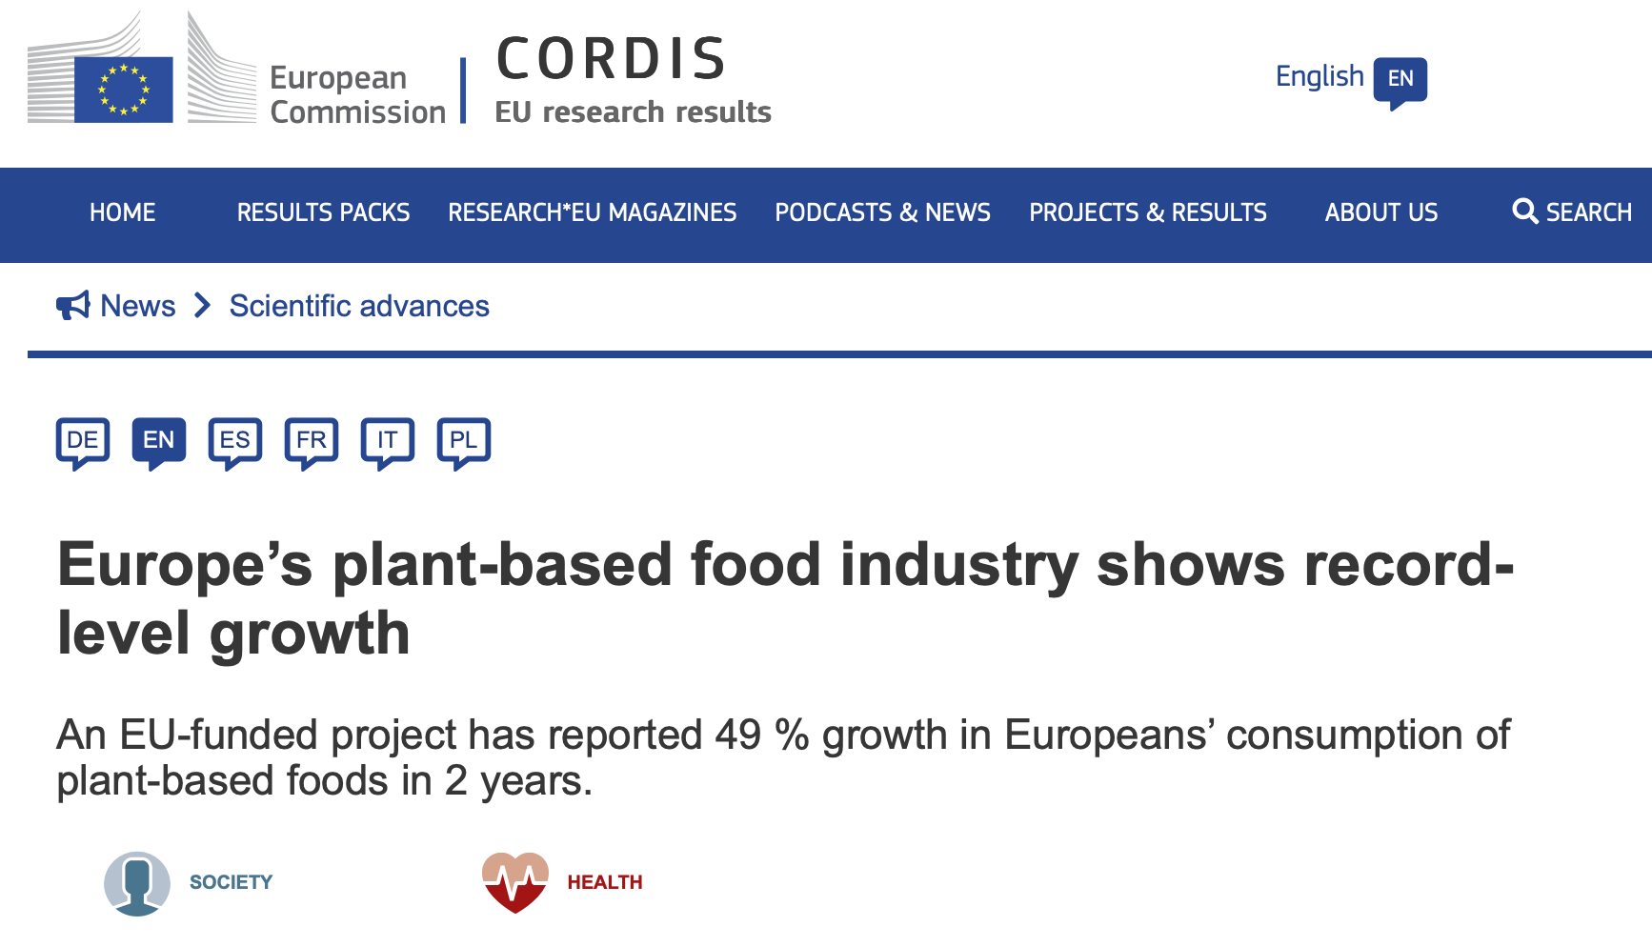
Plant-based is growing fast and consumers are switching away from meat and dairy
Source: European Commission (2021)

Slide 8
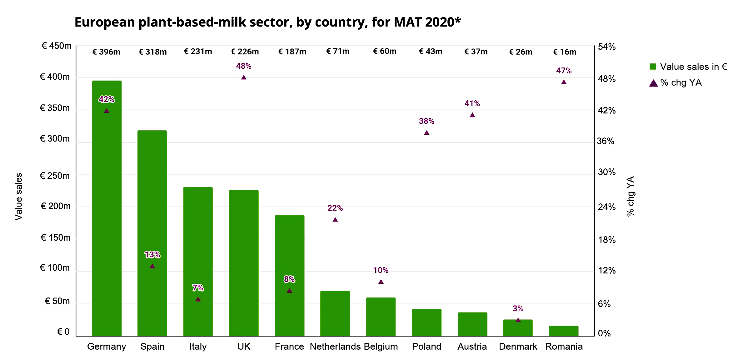
Plant-based milk is growing extremely fast across Europe
Source: European Commission (2021)

Slide 9

84% of consumers of plant-based foods are neither vegetarian nor vegan
Source: SKIM research

Slide 10
Flexitarians are increasingly conscious of the connection between animal products and climate change
Source: European Commission (2021)

Slide 11


Moms would give their child a PB drink to diversify their diet with healthier and more natural options
Reasons to Purchase PB Drink
Source: SKIM Danone study
Notes:
Though top 3 is similar, natural more in FR and variety more in UK

Slide 12



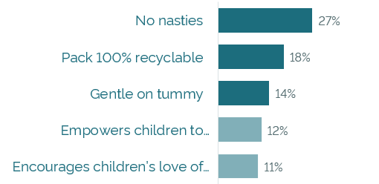
Primary product attributes usually win out followed by concrete and tangible secondary attributes
Preferred Product Statement
“Being able to recycle a package after use is absolutely vital, particularly for a plant-based product whose ethos is based on sustainability.”
In France, naturality (no nasties) is most appealing
“I consider it important to educate our children to lead an environmentally conscious lifestyle. This also creates a nicer future.”
Source: SKIM study plant-based toddler milk

Slide 13
Sustainability will not be more important than primary attributes
However, we can leverage sustainability together with primary attributes to reach even further
Tastes Good
More Important
2. Is Healthy
3. Is Fresh
4. Has no additives and/or no artificial ingredients
5. Is cheap
Less Important
6. Is environmentally and climate friendly
Source: SKIM Danone study

Slide 14

The Science Bit
Notes:
In the middle of the the pandemic

Slide 15




Conducting sustainability research is difficult and complex
We know as citizens how difficult it is for us to take meaningful action in line with our values
The World
Problem
Urgency
Gap
Me
Intention
Action
Impact
Gap
Result

Slide 16

But there are also strong opportunities if we do it right
We know that sustainability innovations offer the opportunities to disrupt habitual behaviors and can help people make better choices in line with their values
Trigger
Reinforce / Disrupt
Love
Choose
Habitual
Loop
Deliberate
Loop
Evaluate

Slide 17
Hypothetical
SKIM Psychological
Distance Model
The real world with all its sustainability issues
Abstract
The world as you know it
Concrete
Spatial
Far
Close
Me
Now
Future
Temporal
Myself
Others
Social

Slide 18


Strong messages lower people’s inhibition to act and increase perceived value
Lower inhibition to act
Claims with low psychological distance reduce the activity in the brain that manages inhibition, increasing the likelihood consumers engage with your brand and act positively upon it as a result
Increase subjective value
Claims that are lower in psychological distance also increase the subjective value the consumer assigns to the option in front of them and positively impacts their decision making in favor of that brand
ACC and inferior frontal gyrus
Ventromedial prefrontal cortex (vmPFC)
Source: MRI research conducted by SKIM and the University of Amsterdam

Slide 19

Principles for Effective Sustainability Comms
Notes:
In the middle of the the pandemic

Slide 20

3 key principles to consider for effective sustainability messaging
Complement, don’t replace, primary benefits
Keep it simple and avoid jargon
Show tangible impact and go all-in

Slide 21

Complement, don’t replace primary benefits
Include message benefits or emotions that the customer is in need of and are relevant to the category

Slide 22
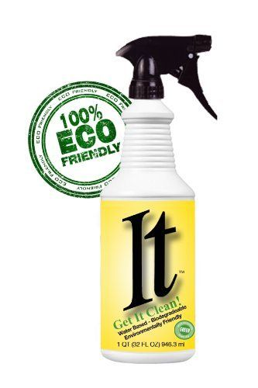
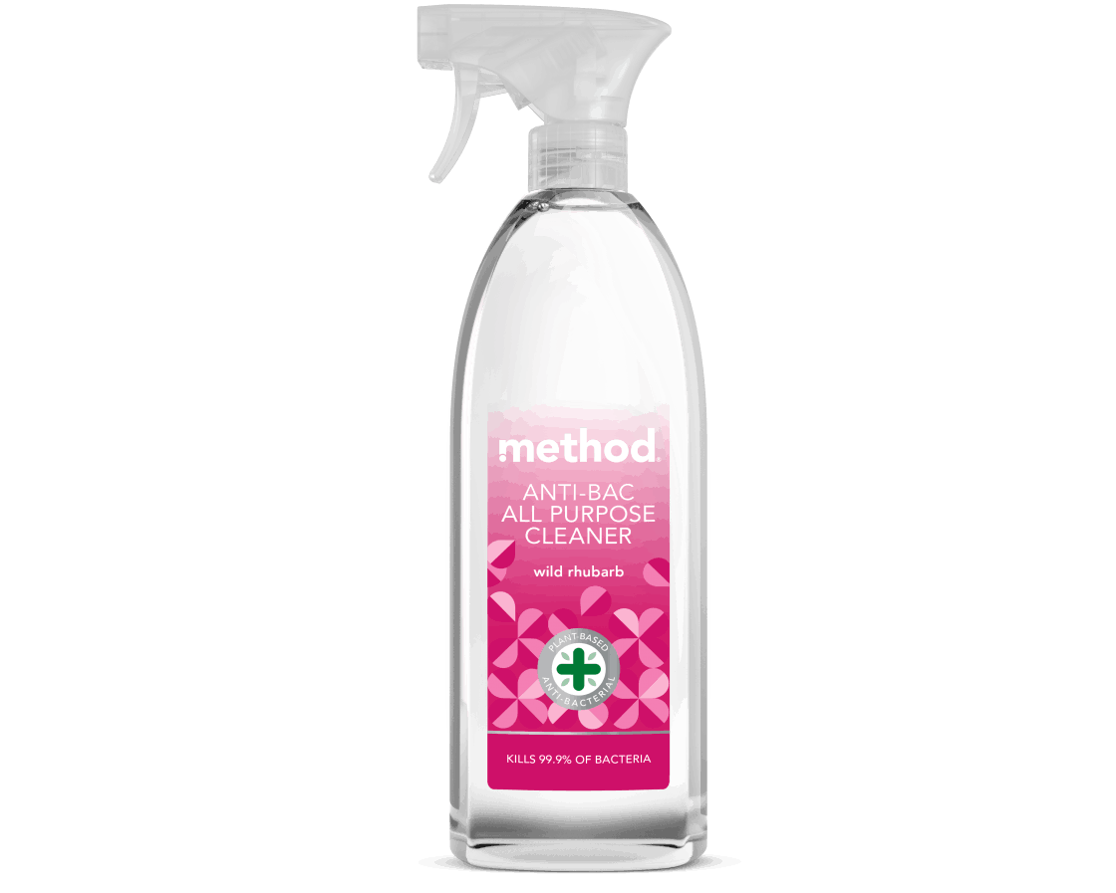
Cleaning products need to emphasise efficacy first, then give consumers sustainability as an added benefit

Slide 23
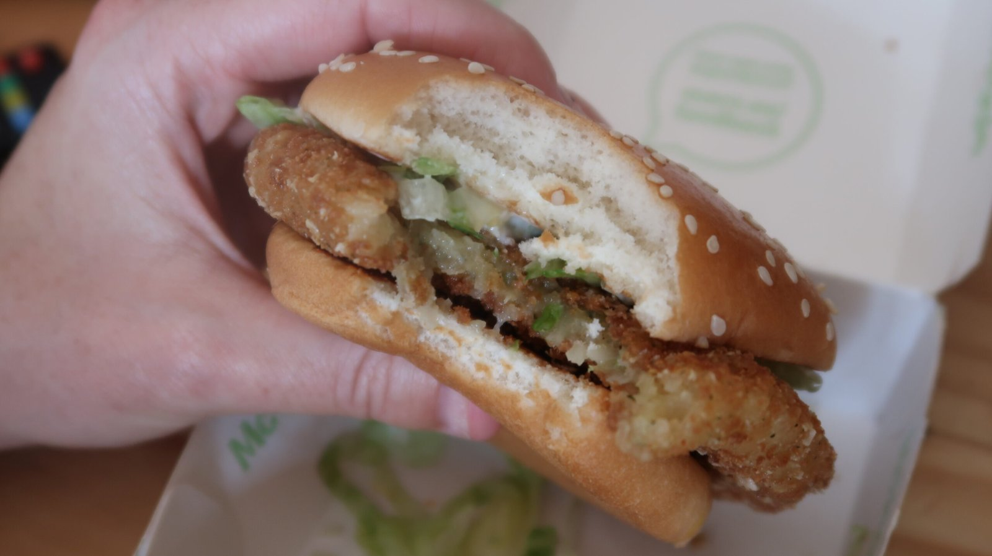
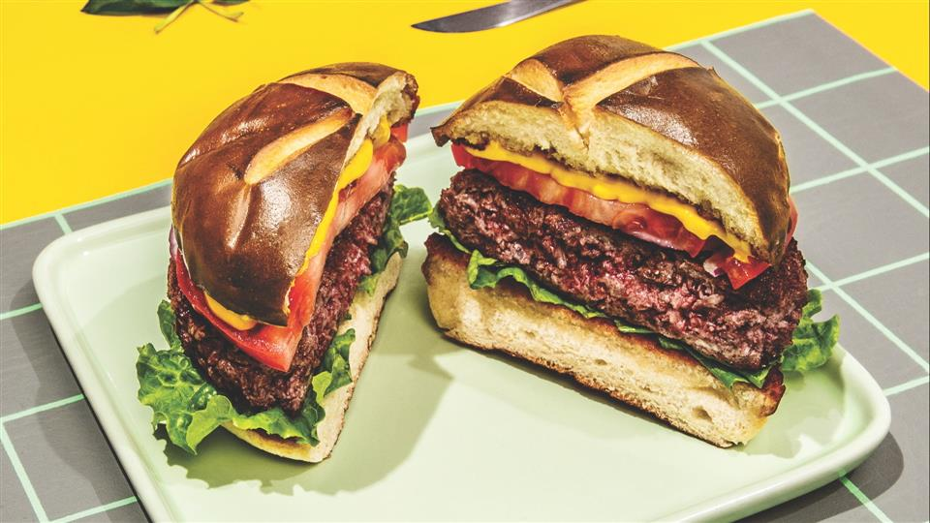
Burgers need to be indulgent first, then guilt free. Veggie burgers in the 1990’s usually fell on the first hurdle

Slide 24

Keep it Simple & Avoid Technical Jargon
Use simple language to ensure your message is understood. Avoid jargon or technical lingo

Slide 25
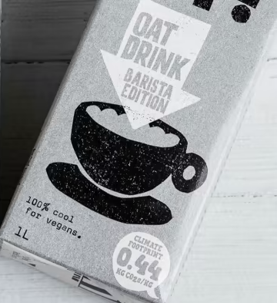
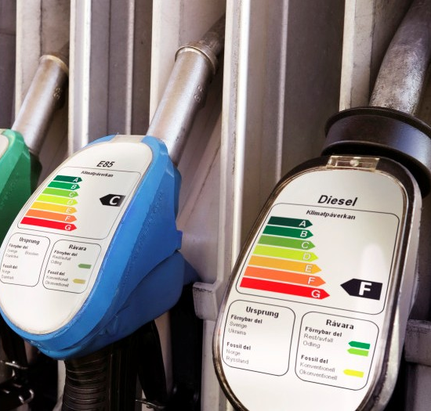
Consumers do not understand “KG CO2e/KG”, but they know that “A” and the colour green means “good”

Slide 26
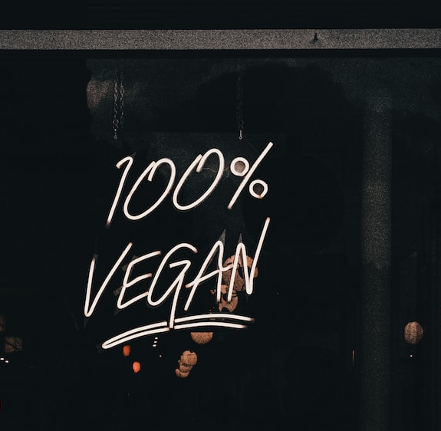
Show Tangible Impact & Go All-In
Try to be definitive, use 100% where possible, and describe the concrete benefits your product will deliver

Slide 27
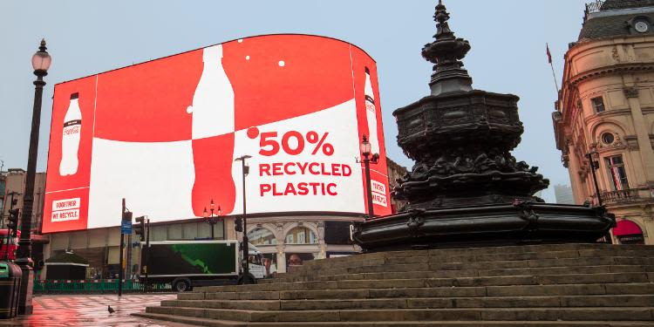
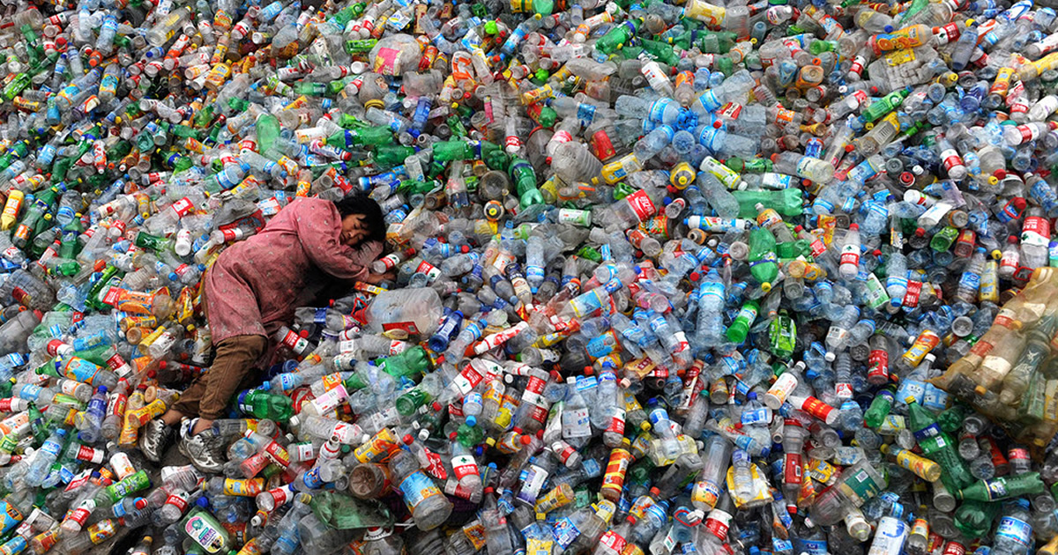
A pack that is 50% sustainable unfortunately brings consumers minds to the other 50% that is not

Slide 28
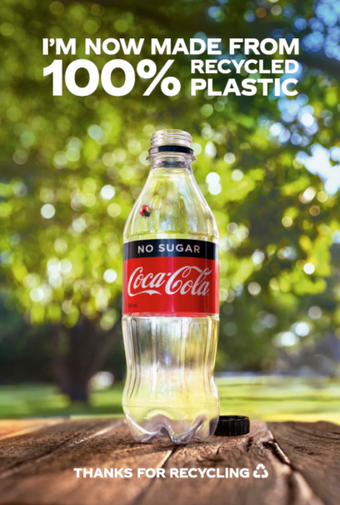
A message containing the promise of 100% sustainability is much more reassuring for consumers

Slide 29

How to create effective sustainability comms
Notes:
In the middle of the the pandemic

Slide 30

Sustainability comms need to be considered from both a tactical and a strategic perspective
Tactical (Short-term)
Strategic (Long-term)
Strengthen brand
New customer segments
Protect category position
Increase consideration
Grow and protect share
Increase market share
Sustainable price premium
Revenue growth
Source: SKIM study

Slide 31
4 key factors determine the success of a sustainability message
Noticeability
4. How engaged is the consumer in sustainability?
Perception
Engagement
Choice
1. Does it get noticed?
3. Does it affect product choice?
2. Is it understood, liked, relevant and trusted?
Source: SKIM study

Slide 32
Consumers relate sustainability most closely to health and price. It can ladder to quality and taste, which ecolabels help promote
Sustainable products use fewer chemicals, pesticides, and preservatives
Higher-quality raw materials, locally sourced (France), and processing means a higher-quality product
Health
Price
Taste
SUSTAINABILITY/
ECO-FRIENDLINESS
Quality
Less processing means fresher and better ingredients
More mindful production, resources and employment, less shortcuts may make sustainable products cost more
Source: SKIM study

Slide 33
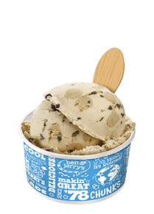
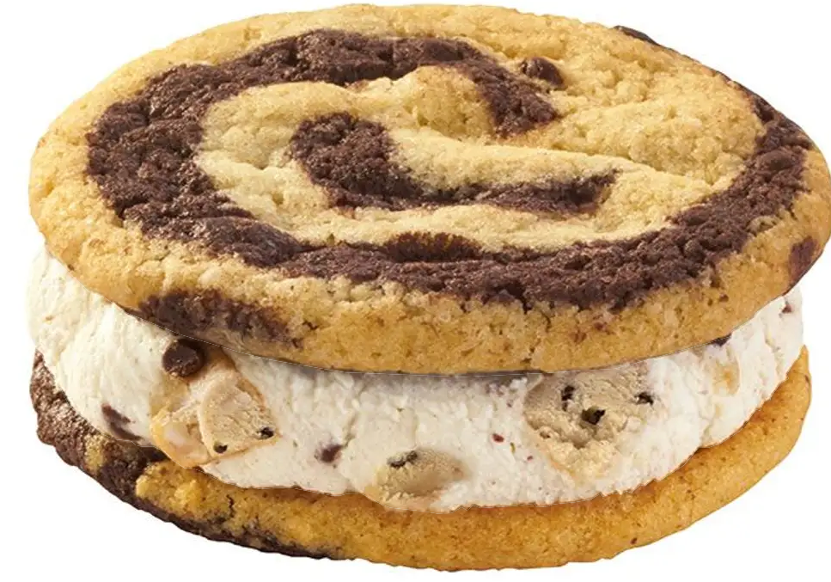
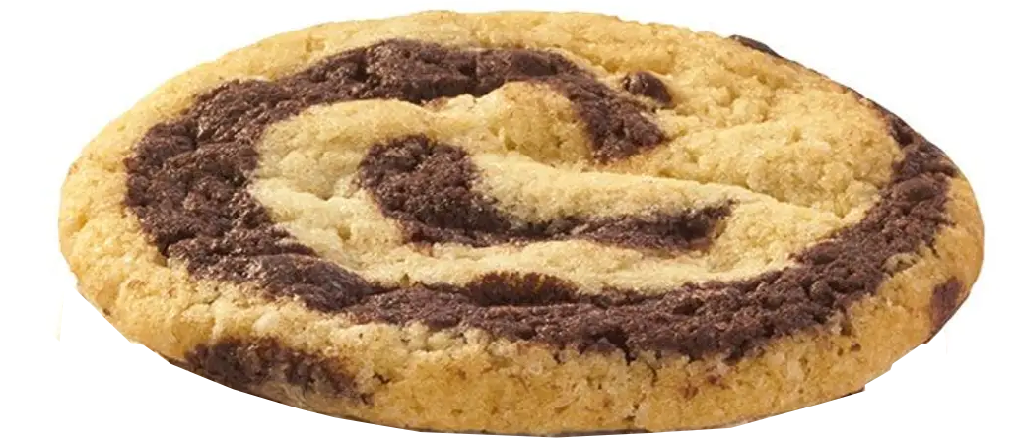
Integrated claims combine a familiar territory with sustainability to create an even stronger claim
Primary Attribute
(e.g. Taste)
Secondary Attribute
(e.g. Sustainability)
In Combination
(e.g. Delicious & Sustainable)
= Non-negotiable
= Nice to Have
= Amazing!
Source. SKIM client study (brand changed)

Slide 34
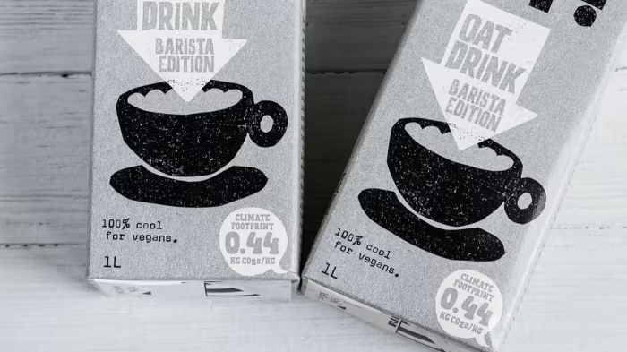
Eco-labels as Shortcuts
Notes:
In the middle of the the pandemic

Slide 35

Ecolabels can have a strong effect on consumer preference
Eco-labels can drive choice
Products with higher eco-scores will increase their market shares, while those with low scores will lose share
The higher the ecolabel grade, the stronger the preference uplift
Using marketing to educate consumers is 4x more effective than the label on its own
All else being equal, ecolabels have the power to move some consumers between brands and even between related categories
Strong Ecolabels Can Increase a Product’s Preference by up to
15%
Source. SKIM client study

Slide 36








EcoImpact is an example of a high-performing label
Bright colors draw attention
Earth imagery creates a clear link to the environment
Simple rating scale with color-coding to support meaning
8-point scale offers additional granularity
Noticeability
Source. SKIM client study

Slide 37



Effective eco-labels can have brand halo effects
Drinks
Food
Ecolabels support a range of positive perceptions
Easy to understand
Relevant - summarizes a range of sustainability factors
Trusted by most consumers
Helps consumers feel good about products they buy
Beneficial halo effects for health, taste and quality
“Better for the planet”
+8%
+11%
“From a brand I trust”
+6%
+7%
“A healthier option”
+4%
+7%
“High-quality ingredients”
+7%
+9%
“Have great taste”
+2%
+6%
Source. SKIM client study

Slide 38
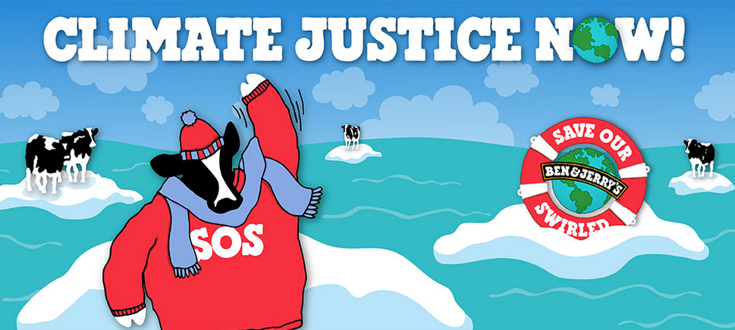
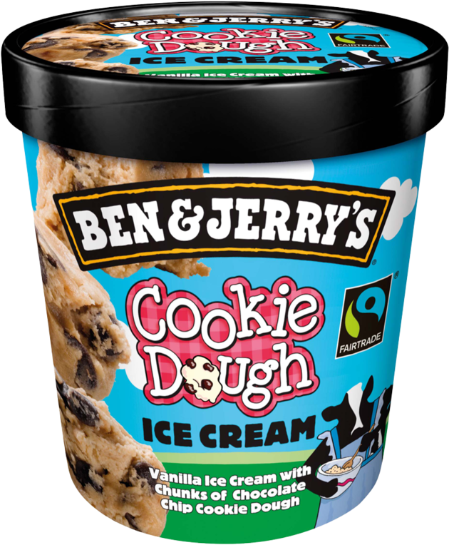
Marketing turbocharges power of carbon labels
Educating people is critical to get the most out of high label scores
Without Ecolabel
Ecolabel Without Marketing
Ecolabel With Marketing
 | Preference uplift: (Mandatory) | Preference uplift: (Mandatory)
Baseline | +4% | +15%
4x
Improvement
Source. SKIM client study (brand changed)

Slide 39

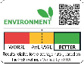

Most labels fail to drive choice, only the highest performing labels have a positive effect
Preference uplift
Preference uplift
Eco-Nut
PEF
EcoImpact
Eco-Nut
PEF
EcoImpact
Food
-3%
+1%
+6%
Drink
-5%
-1%
+3%
Source. SKIM client study (brand and data points changed)

Slide 40

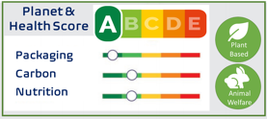


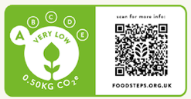


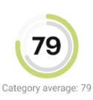
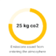


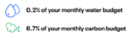
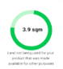

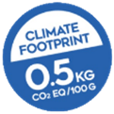

There is a wide discrepancy in the the ability of eco-labels to help consumers make more sustainable choices
*
Easy-to-understand
Driver of Choice
Source. SKIM client studies

Slide 41


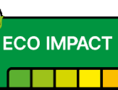
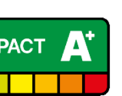
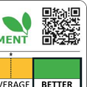
Consumers perceptions and comprehension can be elevated with key design elements
Embedded cultural semiotics
Relevant Imagery
Informative language
Built in Benchmarks
Resources & Verification
Elements like traffic stop coloring (i.e. green to red) and letter grading systems embed meaning with few design elements
Clear graphics that cue environment and sustainability at first glance can help consumers make the link more quickly
Simple language that clearly states what the label signals works better than more technical or more generic messages
Benchmarks aid comprehension and credibility. Within- vs. cross-category benchmarks may anchor consumers’ perceptions differently
Access to additional resources or displaying third-party backing lends transparency and trust to the label, even when consumers don’t intend to explore further

Slide 42
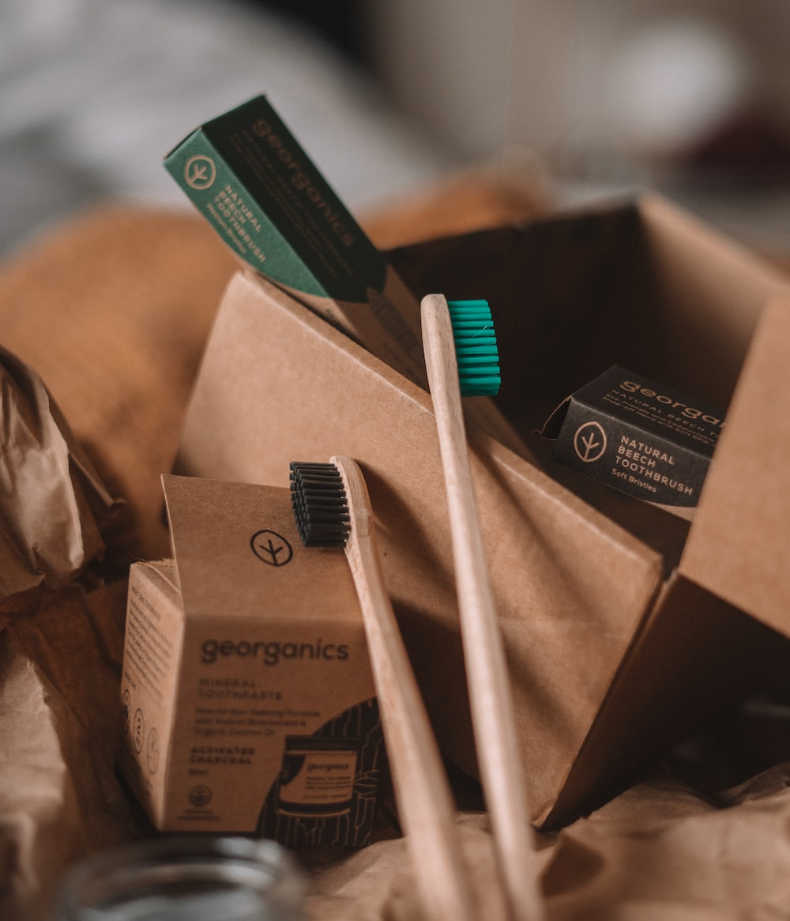
Packaging as a catalyst
Notes:
In the middle of the the pandemic

Slide 43
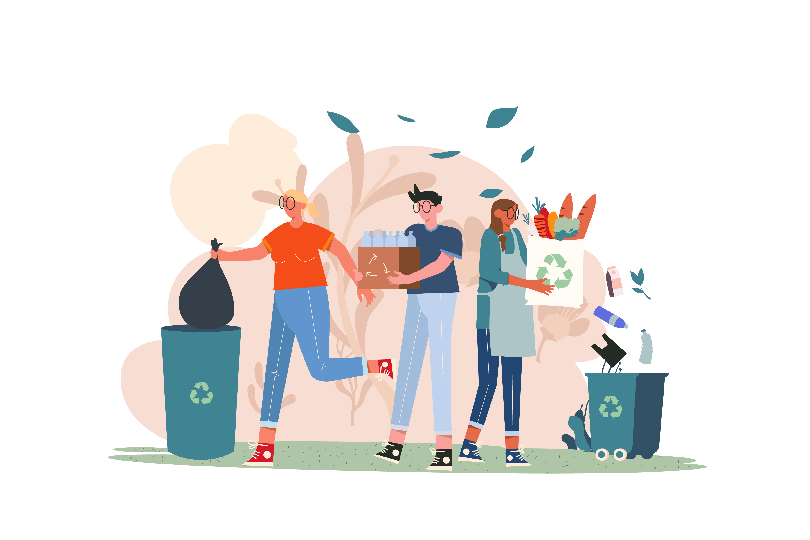
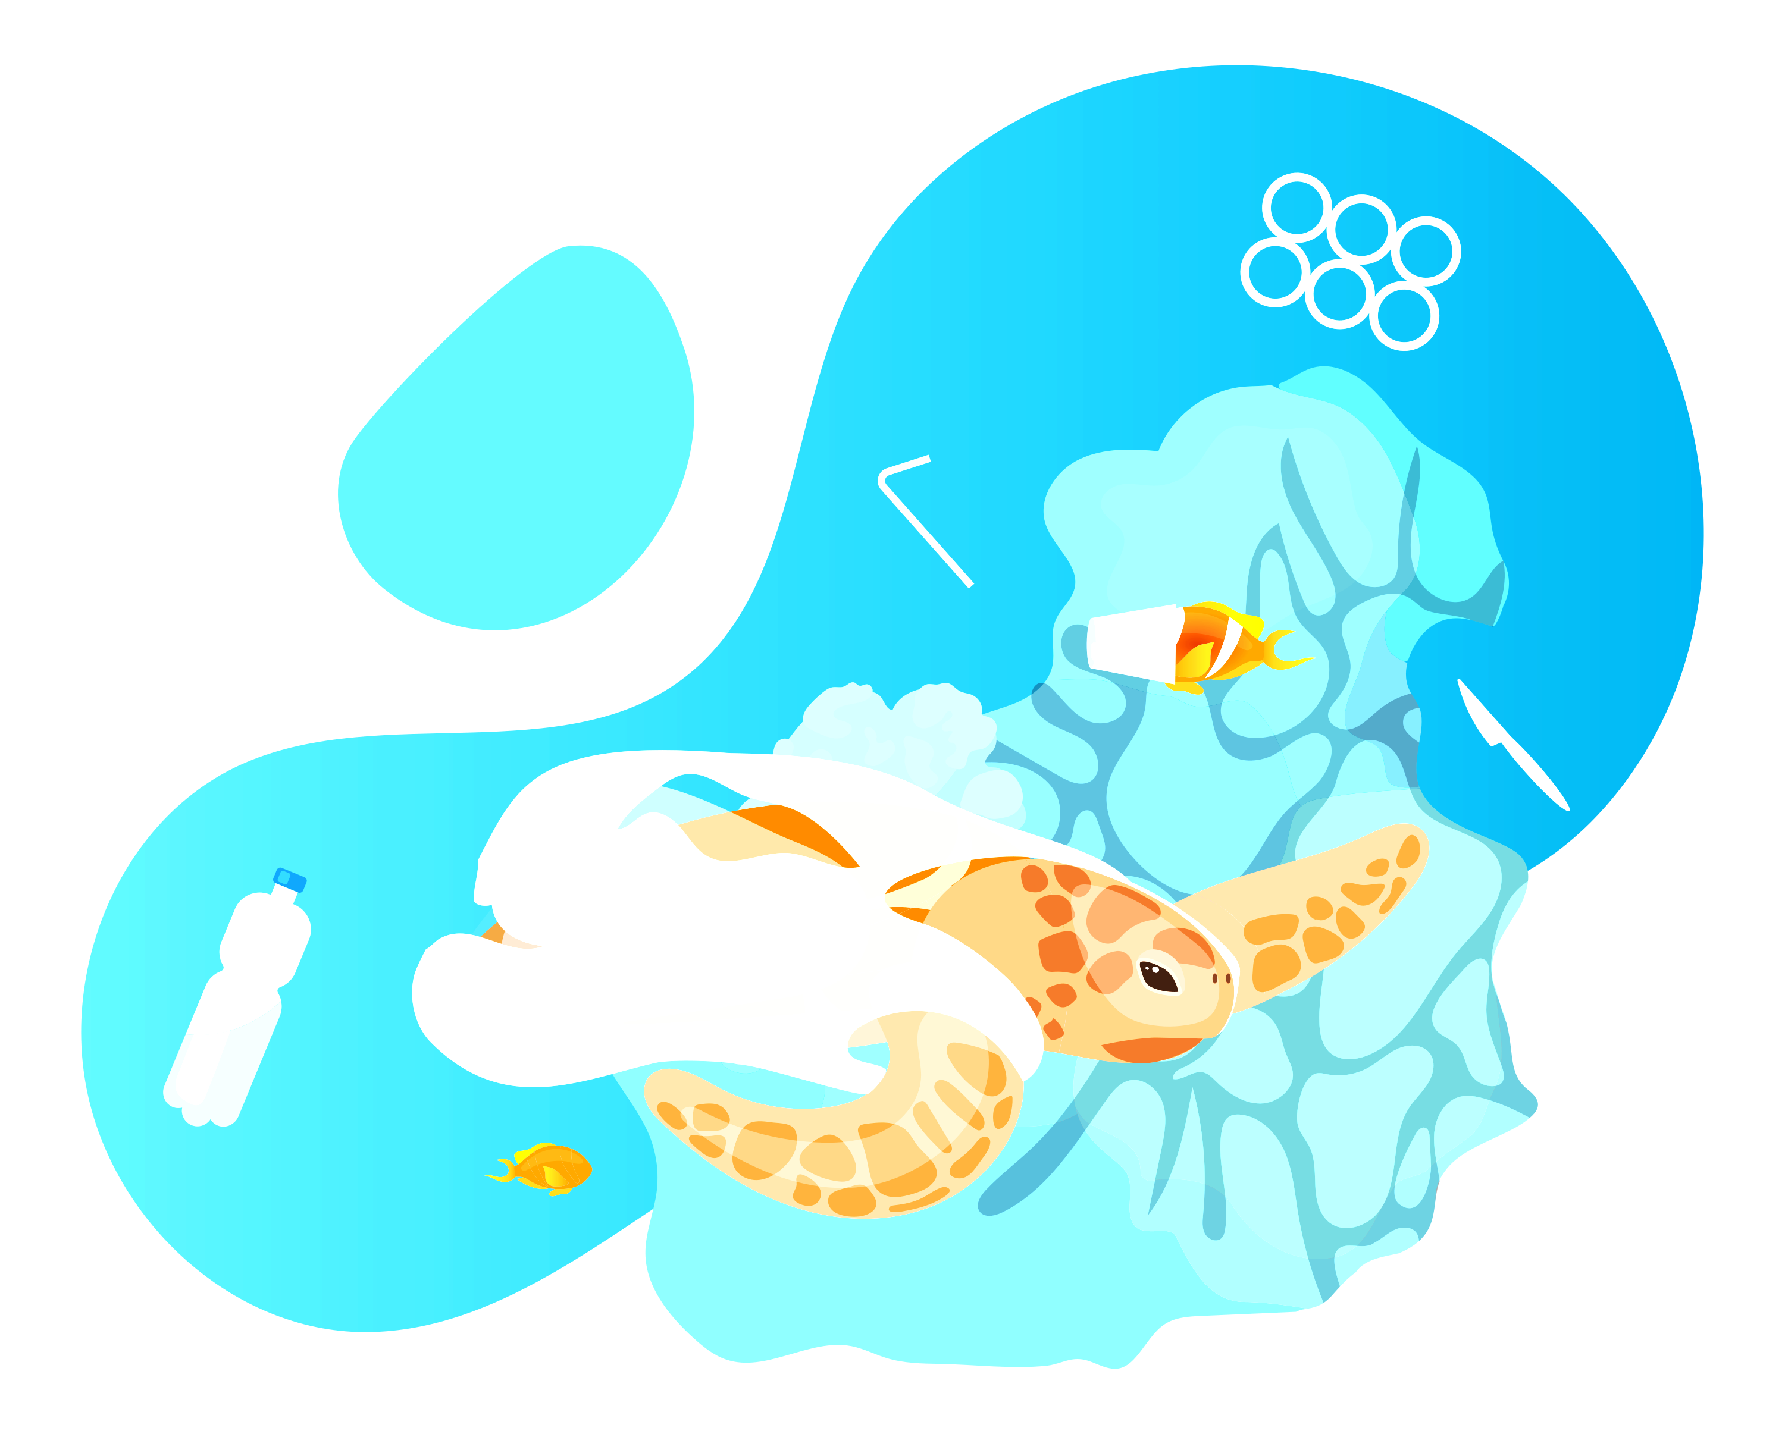
Packaging is a visible and felt aspect for customers
Unlike many other sustainability efforts that are more abstract, such as climate change, packaging is one of the most accessible
Recycling is a habitual behaviour internalised over decades
Plastic waste has been a top environmental concern over the past 5 years

Slide 44
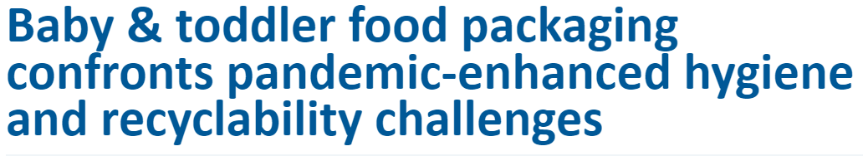

Customers are concerned with packaging and are actively looking for solutions
Packaging Insights
Mum's Net
"That’s so frustrating 😓 you’d think with the amount that is sold the big companies might have had it raised a lot as an issue and worked on different packaging!" - Parent on not being able to dispose non-recyclable tubs of Aptamil
“Parents report deep concern over the environmental impact of infant food packaging: 70% of Spanish parents agree that the environmental impact of baby/toddler food and drink packaging is concerning”
Green Matters
Packaging Insights
"Parents are looking for sustainable packaging options that maintain the same level of convenience, durability and portability" – Sina Hilbert, Sustainability Lead, Nestle Gerber
“Unfortunately, finding zero-waste baby formula is extremely difficult. Whenever possible, buy formula in recyclable containers to minimize carbon footprint and overall waste.”

Slide 45
Packaging frequently comes out as the most tangible and relatable sustainability topic for customers
MORE
TANGIBLE
“Plastic waste produced from products is currently piling up in the world. This waste has a detrimental affect on the planet, people’s health and wellbeing and needs to be managed responsibly. Producers should find ways to re-using waste.”
LESS
RELATABLE
MORE RELATABLE
“Using fossil fuels increases the total amount of carbon in the environment and is partly responsible for global warming, and the energy and ingredients to produce this product require burning considerable amounts of fossil fuels.”
LESS
TANGIBLE
Source: client project in the plant-based category

Slide 46
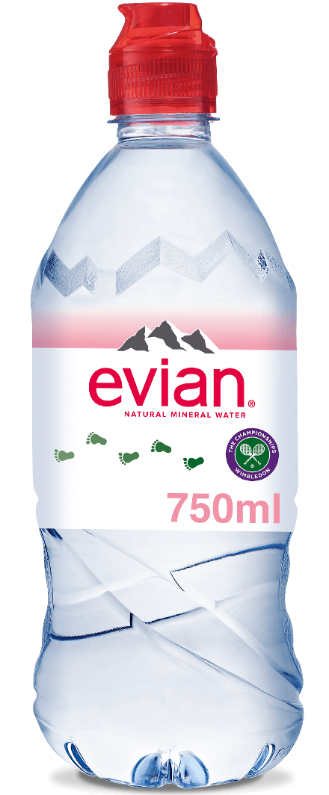
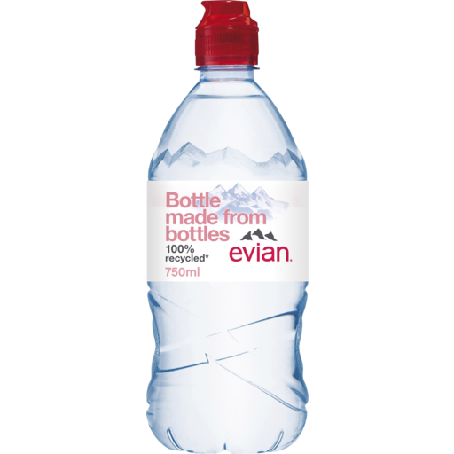
Previous research has shown that is categories where product quality is equivalent, sustainable packaging can have a considerable impact
Old Bottle without rPET
New Bottle with rPET
New Bottle with rPET
 | Total Sample Preference uplift: | Eco-Conscious Segment Preference uplift:
Baseline | +10% | +20%
Source: SKIM study on drinks (brand and data changed)

Slide 47
Innovative packaging can be an opportunity to disrupt
Sustainability innovations offer the opportunity to disrupt habitual behaviors and help people make better choices
Trigger
Reinforce / Disrupt
Love
Choose
Habitual
Loop
Deliberate
Loop
Evaluate

Slide 48

Bringing It All Together
Notes:
In the middle of the the pandemic

Slide 49






The SKIM approach to creating a strong sustainability strategy
Claims & labels Refinement
Based on the inputs from the workshop, we do a final test where we narrow down the labels and claims to obtain the winners we are happy to proceed with.
5
2
Pilot Initiatives
Using the evidence-based playbook we start rolling out pilots for further research or market testing to gather learnings, iterate, and scale.
1
3
4
Revenue & Brand Growth
Activation & Playbook
Sustainability Workshop
We then run a choice model including our winning labels and claim to understand what the strongest combination is and what the revenue and market share impact is.
Based on the customer insights, we will develop a strategy and a playbook. We then socialize it through workshops with all stakeholders and plan pilots and implementation together.
We run a workshop to align and engage all stakeholders and create the starting point for our strategy. Together we generate ideas to be further refined in the next steps.

Slide 50
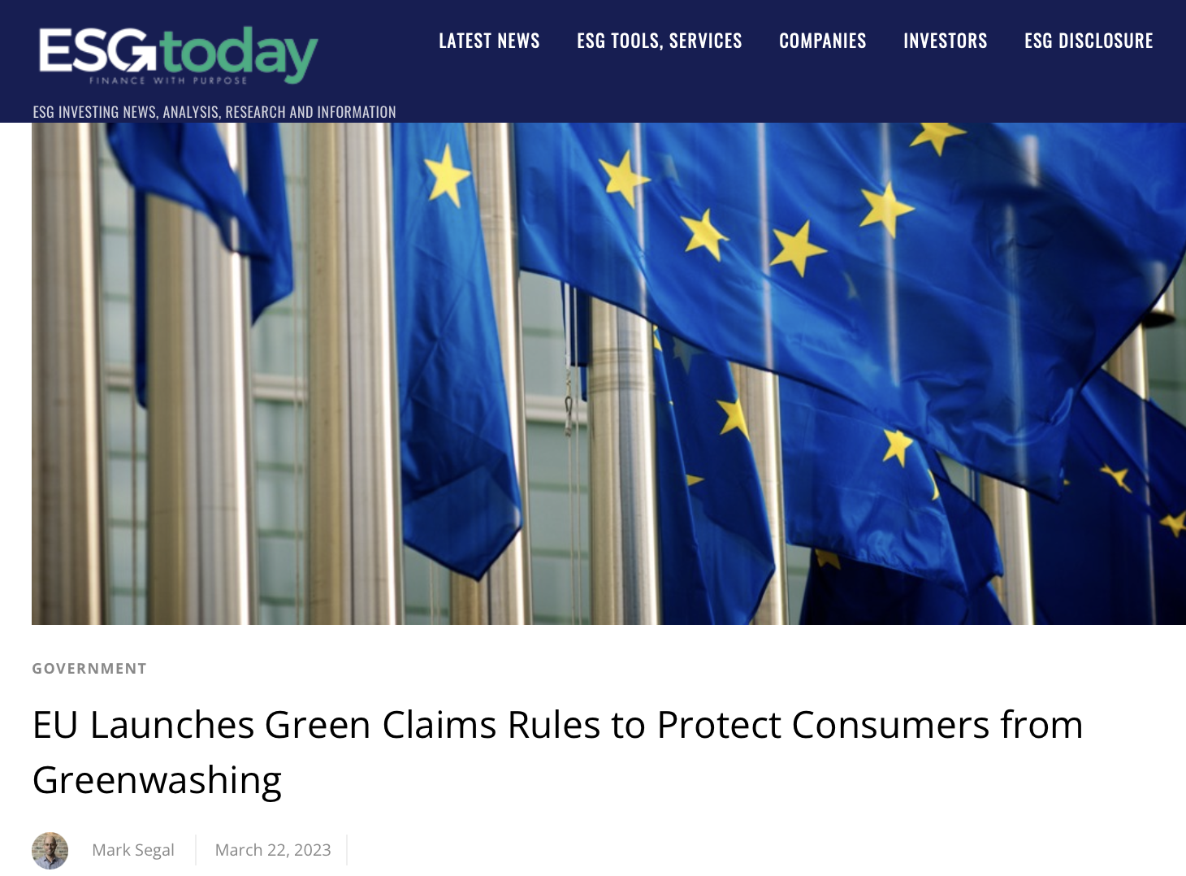
It is important to ensure that any claims are science-based and independently verified – involve technical teams in the process
“
Green claims are everywhere: ocean-friendly t-shirts, carbon-neutral bananas, bee-friendly juices, 100% CO2-compensated deliveries and so on. Unfortunately, way too often these claims are made with no evidence and justification whatsoever. This opens the door to greenwashing and puts companies making genuinely sustainable products at a disadvantage.
Frans Timmermans, Executive Vice-President for the European Green Deal
”

Slide 51






Thank you
David Voxlin
Director, Sustainability
d.voxlin@skimgroup.com
SKIMgroup.com

